Slide 1
Coronatimes: COVID 19 Prediction using Time series forecasting
Group Members:
Bhargav Teja Jakku – G01334185
Naresh Kukkapalli – G01340317

Slide 2
TABLE OF CONTENTS
01
02
Introduction
Problem statement
03
04
Data Preprocess
Data Visulazation
05
06
Time Series Forecasting
Results and conclusion

Slide 3
INTRODUCTION
The coronavirus(SARS-CoV-2) was first identified on December 31, 2019.
COVID-19 is the first pandemic since the 2009 swine flu pandemic.
Viruses evolve over time as they spread and replicate. The CDC tracks and continues to monitor virus changes, called variants.
It's a real-world dataset derived from 'our world data.’
The dataset consists of various locations and their recorded cases respectively.

Slide 4
GOALS
To investigate covid19 behavior where the virus is prevalent.
Compare the number of covid cases and fatalities in three nations.
Modeling and Forecasting the upcoming Covid Cases.

Slide 5
Methodology and approach
The information is gathered from the website "ourworldindata," which contains over 150K records.
We calculate the rolling mean of the number of new cases and fatalities to illustrate them.
Covid19 analysis in three nations.
Two functions to draw the sampled graphs and forecast the covid cases.
Forecasting the future Covid Cases with an RNN Model.

Slide 6
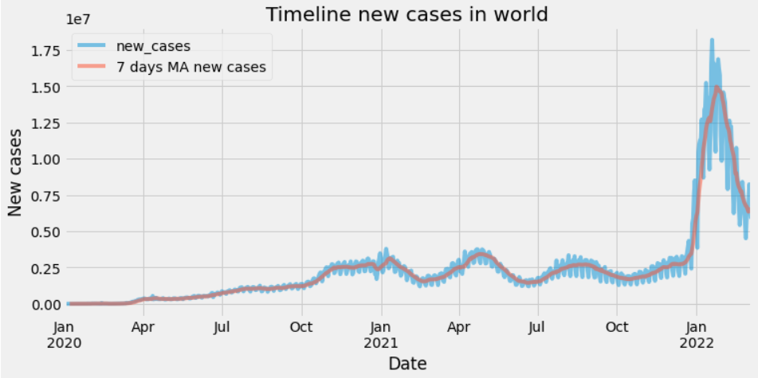
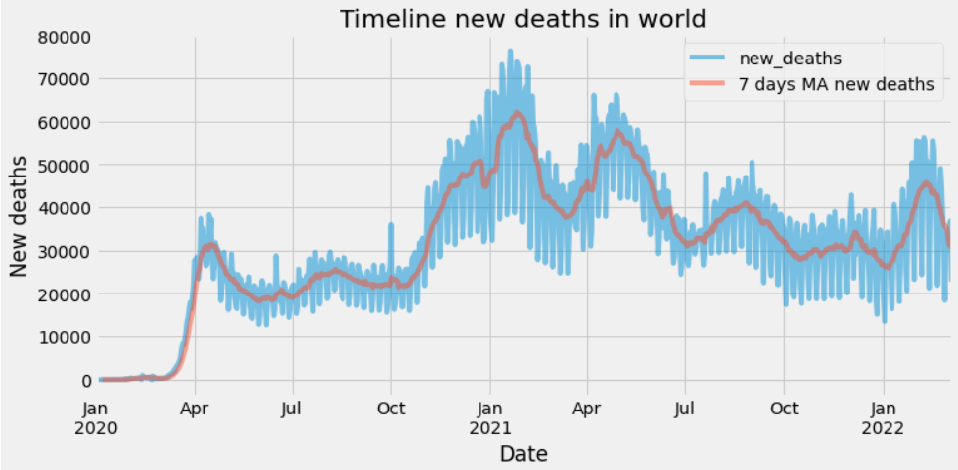
Data Visualization
The graphs below show the timeline of new cases and fatalities throughout the world.
We may detect certain rise in the beginning of each year in the new cases timeline.
There was a significant mortality rate in the beginning of 2021 and 2022 in the new deaths timeline. why?

Slide 7
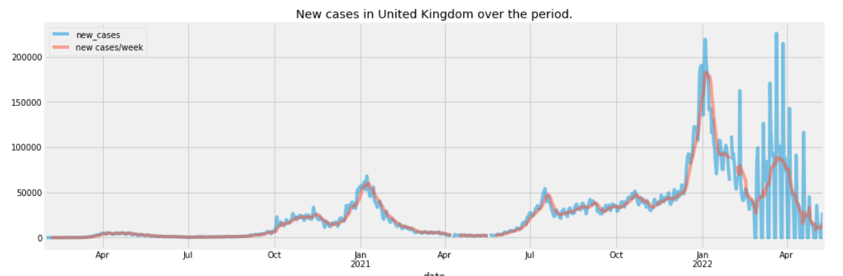
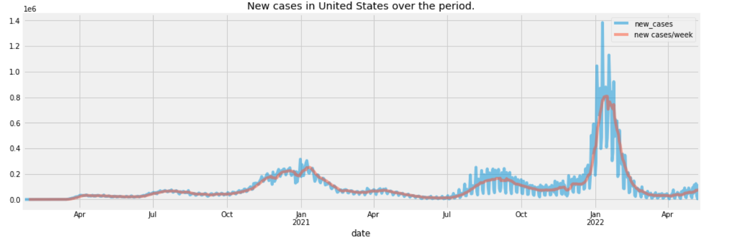
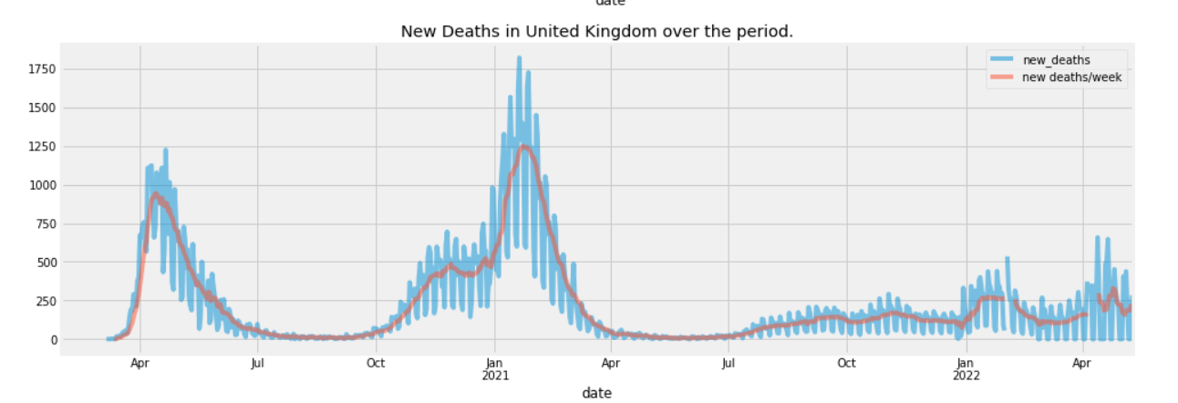
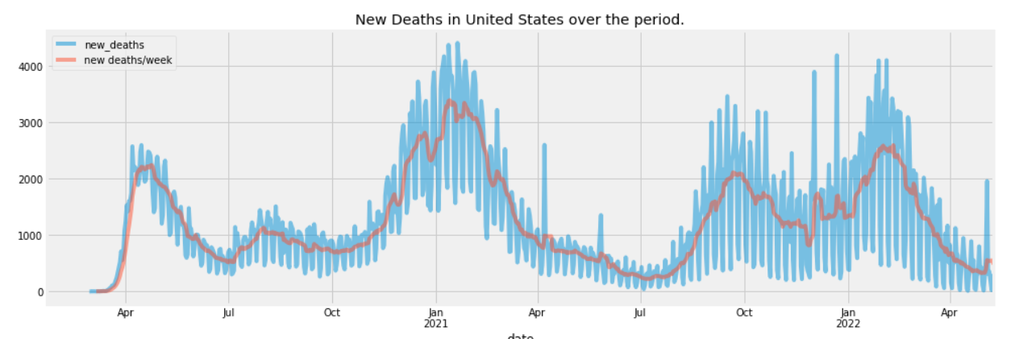
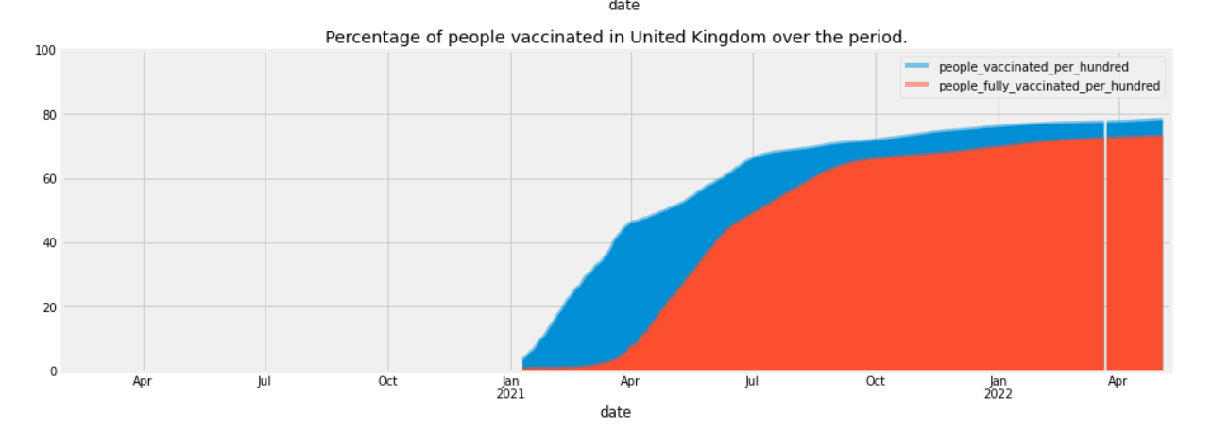
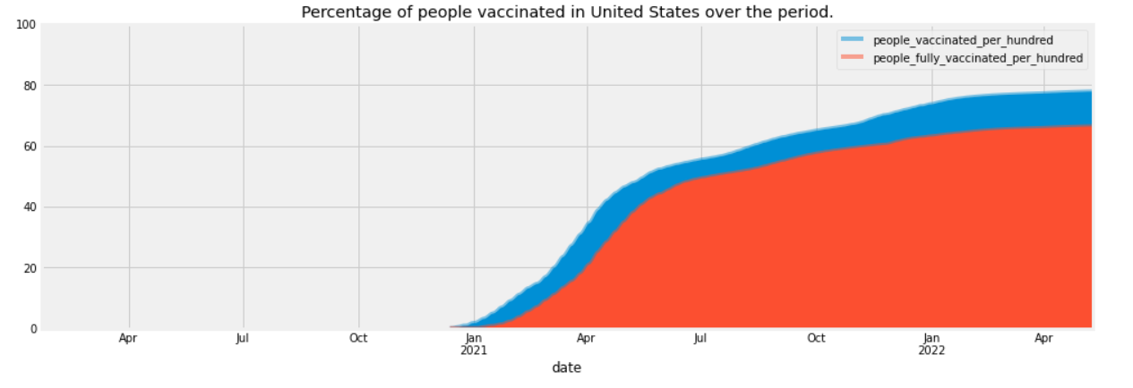
Data Visualization

Slide 8
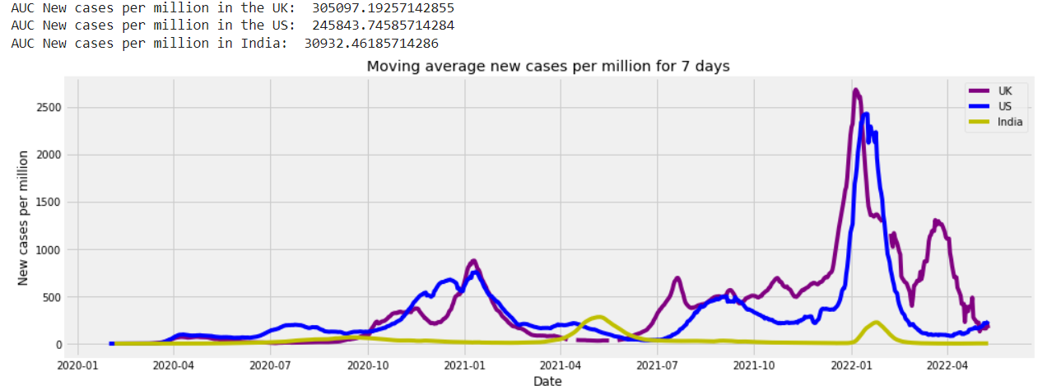
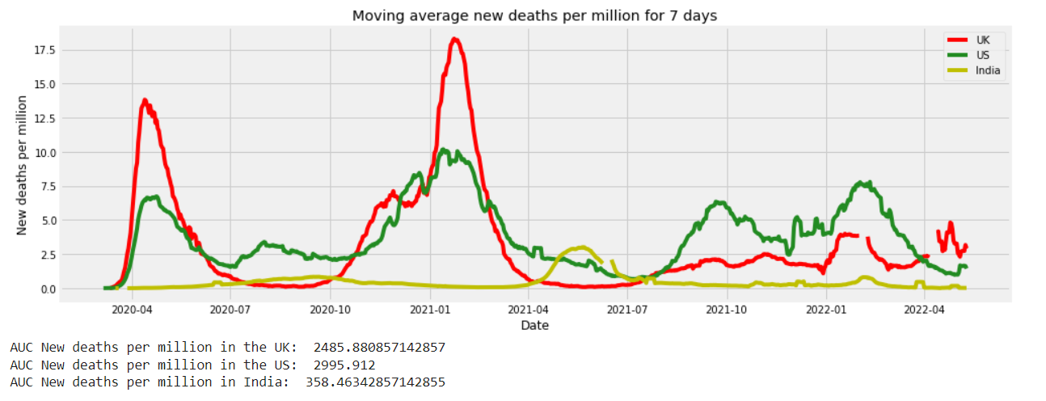
Data Visualization
Comparison of three nation :
We decided to compare the total records per million in Uk, Usa, India.
Uk has the highest number of new cases records with 305097(per million)
However, the highest mortality rate was in Usa with 2485(per million)

Slide 9
Rnn Model
RNN works on the principle of saving the output of a particular layer and feeding this back to the input in order to predict the output of the layer.
An RNN can handle sequential data, accepting the current input data, and previously received inputs.
RNNs can memorize previous inputs due to their internal memory.

Slide 10
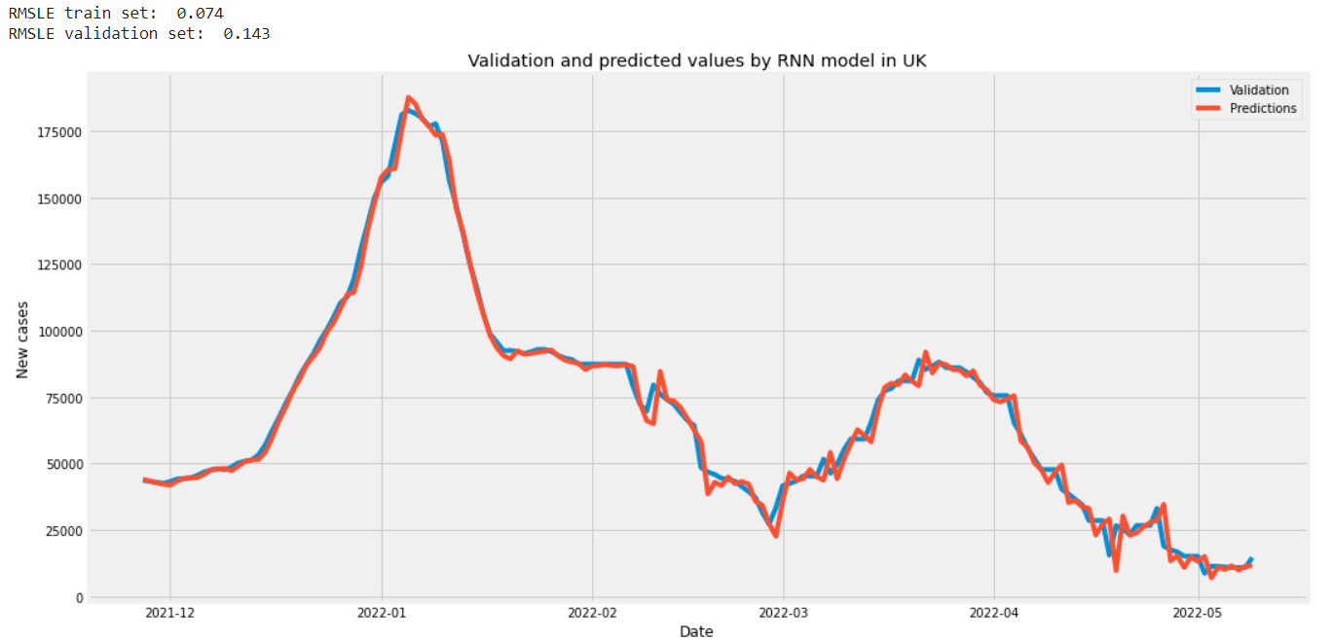
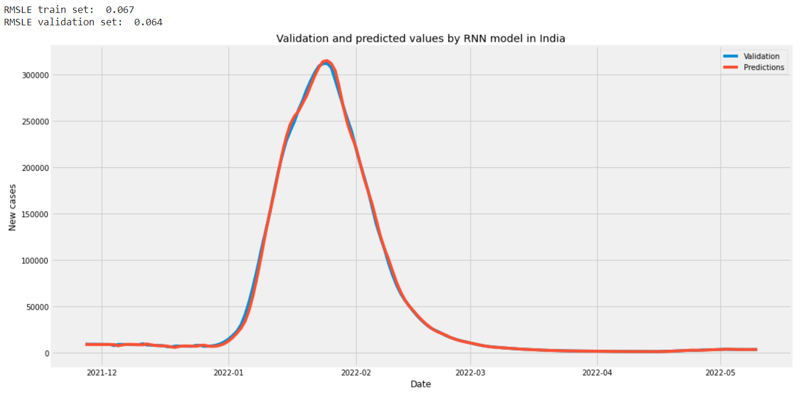
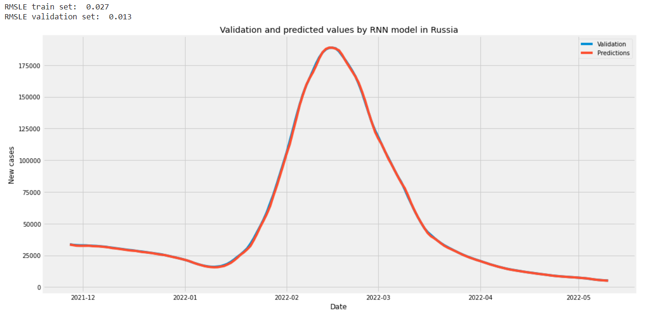
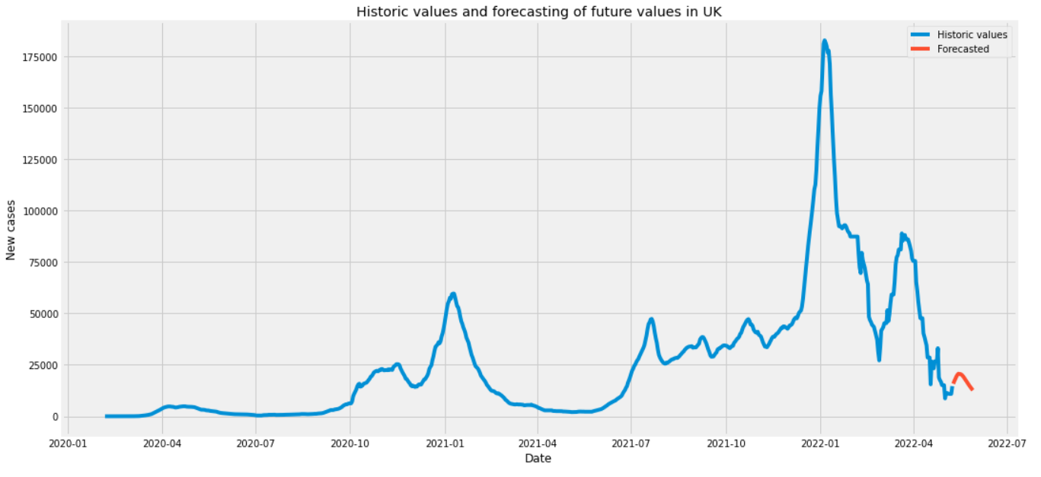
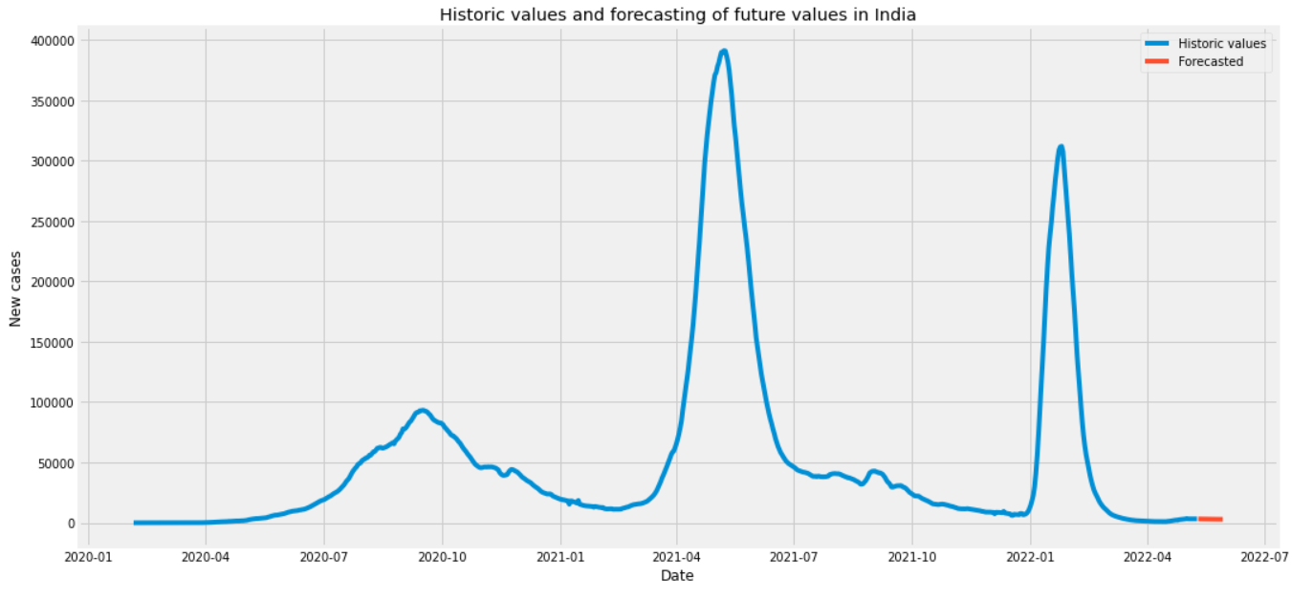
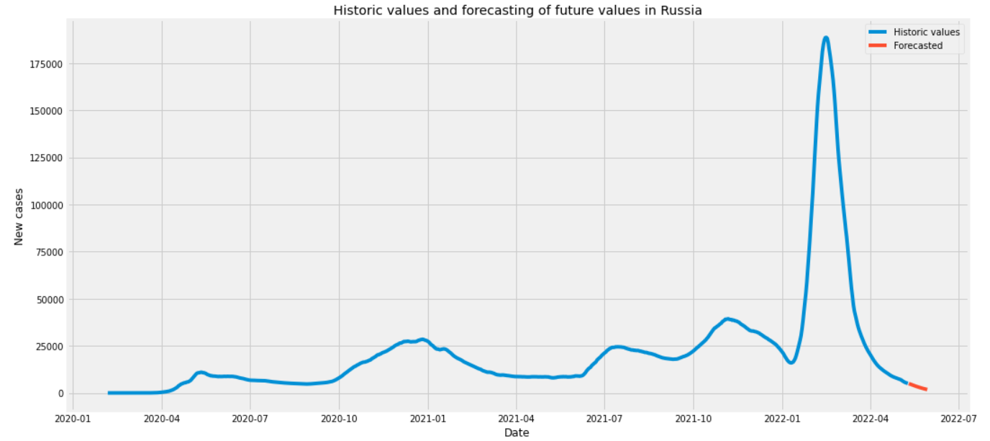
Time Series Forecasting
UK
India
Russia

Slide 11
Scores
Country | RMSLE – Training Set | RMSLE – Validation Set
UK | 0.074 | 0.143
India | 0.067 | 0.064
Russia | 0.027 | 0.013

Slide 12
Conclusion
In conclusion, we tried to perform some EDA to get the insights about the new cases and new deaths for the world and for three countries.
We found out that there is significant decrease in number of cases after people started taking vaccines.
Like our analyses, the forecasted values shows a downfall in covid cases and calculated their RMSLE.
Therefore, we can state that covid has a huge impact on everyone’s life. And we can suppress the dieases by taking all vaccinations.

Slide 13
70,500,000
Number of fully vaccinated covid in the world

Slide 14
THANKS!

